Slide 1
Deep Neural Networks
Building blocks of
deep neural networks

Slide 2
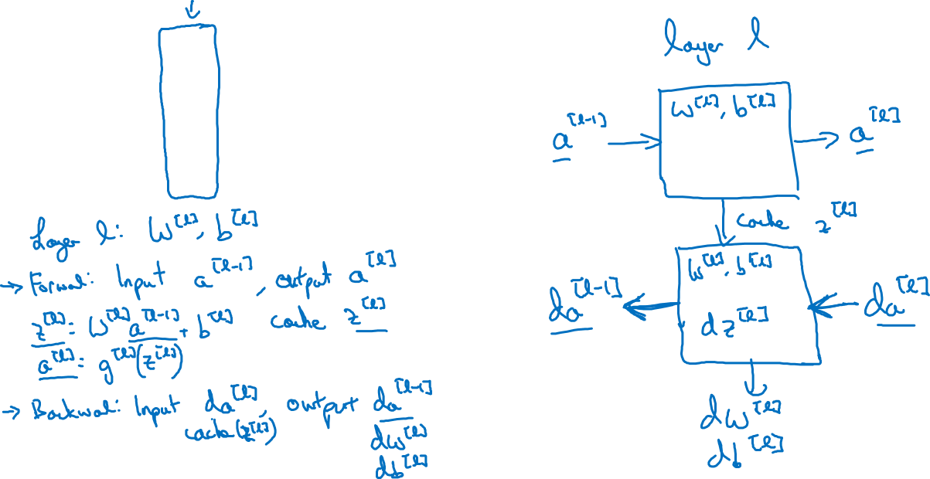






Forward and backward functions

Slide 3
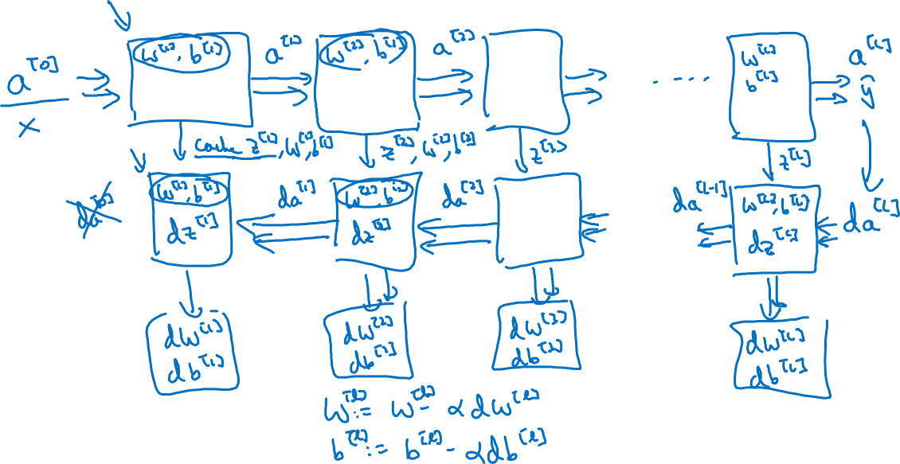
Forward and backward functions
1 Iteration

Slide 4
Deep Neural Networks
Forward and backward
propagation

Slide 5
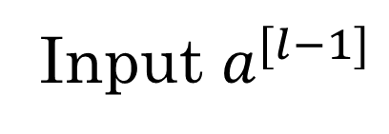
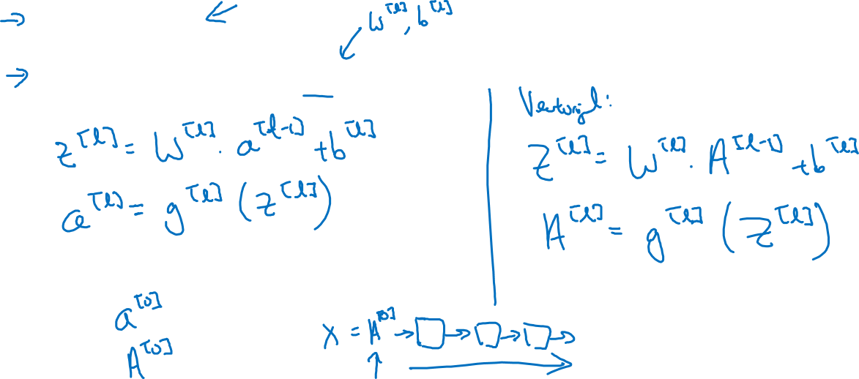
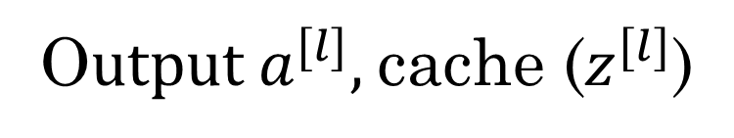
Forward propagation for layer l

Slide 6
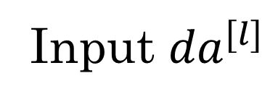
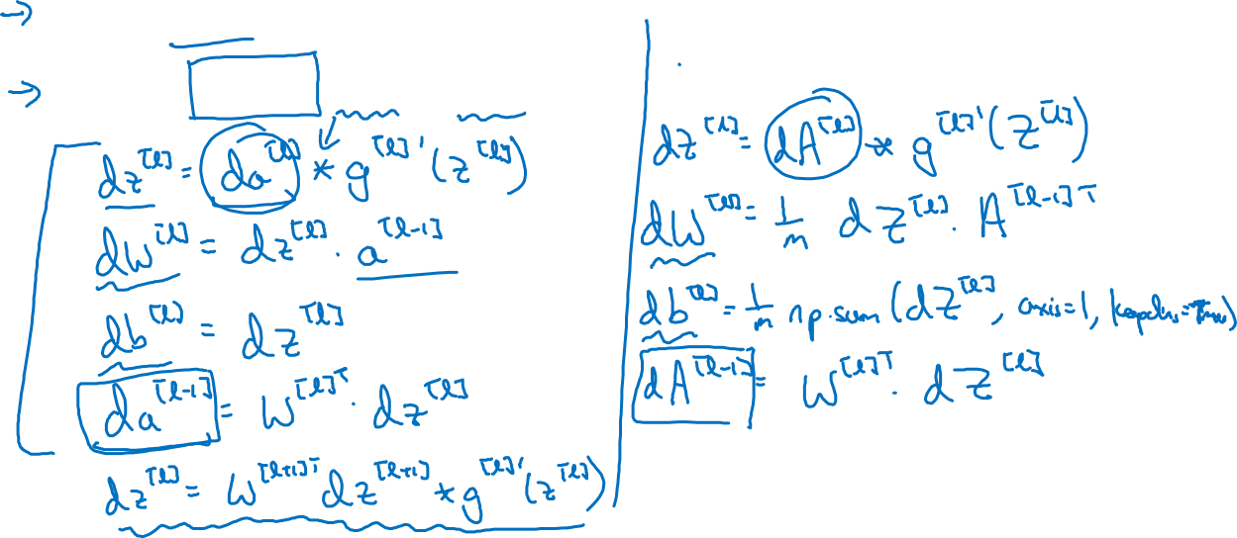
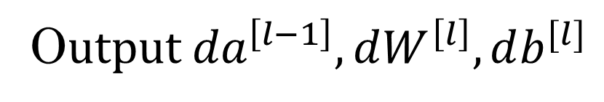
Backward propagation for layer l

Slide 7
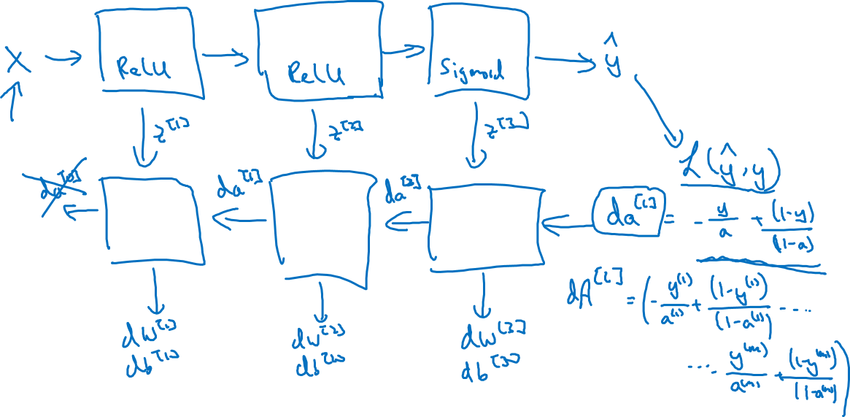
Summary

